Slide 1
Constraint Satisfaction Problems
Chapter 6

Slide 2
Constraint Satisfaction Problems
Problems can be solved by searching in a space of states
In CSP, each state is represented by a set of values.
CSP Search algorithm takes advantage of the structure of states.
It uses general purpose heuristics (rather than problem-specific heuristics) to enable solution of complex problems.
The main idea is to eliminate large portion of search space all at once by identifying variable/value combination that violate constraints.

Slide 3
Defining Constraint Satisfaction Problems
CSP consists of three components X, D and C
  X is a set of variables {X1, X2, ….. Xn}
  D is the set of domains, {D1, D2, … Dn} for each variable.
  C is a set of constraints that specifically allows the combinations of values
Each domain consists of a set of allowable values {v1, v2 … vk} for variable Xi.
Each constraint Ci consists of a pair (scope, rel)
  Scope is a tuple of variables that participates in the constraint
  Rel is the relation that defines the values that those variables can take.

Slide 4
Defining Constraint Satisfaction Problems
A relation can be represented as an explicit list of all tuples of values that satisfy the constraint, For example
  Scope = {X1, X2}
  Rel = [(1,2), (2,1), (1,3),(3,1),(2,3),(3,2)] #all pairs where X1 ≠ X2
A relation can also be defined as an abstract relation to represent it in a generalized way, For example
  Scope = {X1, X2}
  def rel(x1, x2):
  return x1 != x2 # Rule for X1 ≠ X2

Slide 5
Defining Constraint Satisfaction Problems
To solve a CSP, we need to define state space, and a valid list of solutions
Each state in a CSP is defined by an assignment of values to some or all of the variables
An assignment that does not violate any constraints is called a consistent or legal assignment
A complete assignment is one in which every variable is assigned, and a solution to a CSP is a consistent, complete assignment.
A partial assignment is one that assigns values to only some of the variables.

Slide 6
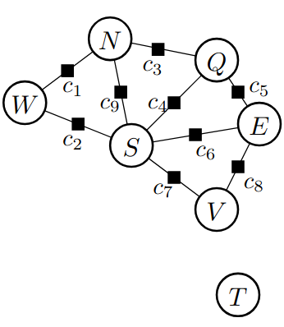
Defining Constraint Satisfaction Problems
A CSP correspond to a constraint graph.
A constraint graph is a bi-partite graph where nodes are variables, and the boxes are constraints.
Constraints may contain several or one variable.

Slide 7
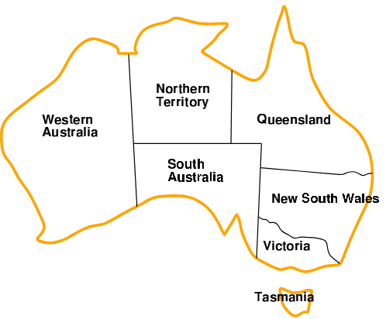
Example: Map coloring
Variables: W, N, Q, E, V, S, T ( E = New South Wales)
Domains: Di = {red, green, blue} for all variables
Constraints: adjacent regions must have different colors e.g W!=N
(W,N) = {(red, green), (red, blue), (green, blue), …. }

Slide 8
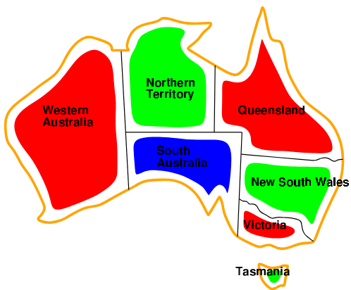
Example: Map coloring
Solutions are assignments satisfying all constraints, e.g.
  {W=red, N=green, Q=red, E=green, V=red, S=blue, T=green}

Slide 9
Why formulate a problem as CSP?
CSPs yield a natural representation for a wide variety of problems
  If you have CSP solving system, it is easier to use it to solve other problems that can be represented as CSP, rather than to design custom solution.
CSP solvers can be often faster than state-space searches
  CSP solvers can quickly eliminate large portion of search space
  Like once we have set {SA=blue}, we can quickly conclude that none of the other state can be given blue color.
  Without taking advantage of constraint propagation, the five neighboring states will explore 3⁵ = 243 color assignments
  By considering constraints it explores only 2⁵=32 colors
In regular state-space search we repeatedly ask if a state is a solution or not? In CSP, we know which constraint is not met.

Slide 10
Varieties of CSPs
Discrete variables: finite domains; each Di of size |Di| = d ⇒ O(d^{n})
complete assignments
  e.g., Boolean CSPs, incl. Boolean satisfiability infinite domains (integers, strings, etc.)
  e.g., job scheduling, variables are start/end days for each job
  constraints solvable, nonlinear undecidable
    A nonlinear constraint is one that cannot be expressed as a simple linear equation/inequality (like aX + bY ≤ c).
    Example of nonlinear constraint: X⋅Y=Z or X²⁺Y² = Z
    These are often harder to solve due to more complex interactions between variables.
    Undecidable means there is no algorithm that can determine, for every possible instance, whether a solution exists.

Slide 11
Varieties of CSPs
Continuous variables
  e.g., start/end times for Hubble Telescope observations
  linear constraints solvable in poly time by LP methods
Real-world examples
  Assignment problems, e.g. who teaches what class?
  Timetabling problems, e.g. which class is offered when and where?
  Hardware configuration
  Transportation/Factory scheduling

Slide 12
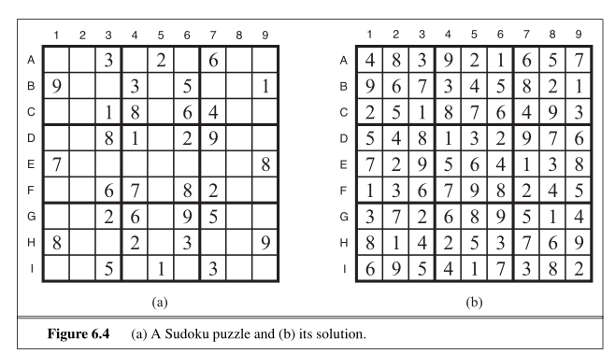
Types of the constraints
Unary constraints involve a single variable, |I_{k}| = 1
  _x0010_Australia example [(SA), SA !_x0007_= green]_x0011_
Pair-wise or binary constraints involve pairs of variables, |I_{k}| = 2
  e.g., SA != NSW
  It can be represented as a constraint graph.
Higher-order constraints or global constraint involve 3 or more variables, |I_{k}| > 2
  e.g., Sudoku (All variables in a row or column must satisfy AllDiff constraint)

Slide 13
Method for solving CSP
Sequential assignment approach
Let’s start with the straightforward but inefficient approach, then fix it
We assign variable values sequentially; the solver state is defined by the values assigned so far. The solver’s decision process is defined by:
  Initial state: the empty assignment, { }
  Successor function: assign a value to an unassigned variable that does not conflict with current assignment ⇒ fail if no feasible assignments (not fixable!)
  Goal test: the current assignment is complete
Every solution appears at depth n with n variables ⇒ use depth-first search
b = (n − l)d at depth l, hence n!d^{n} leaves!

Slide 14
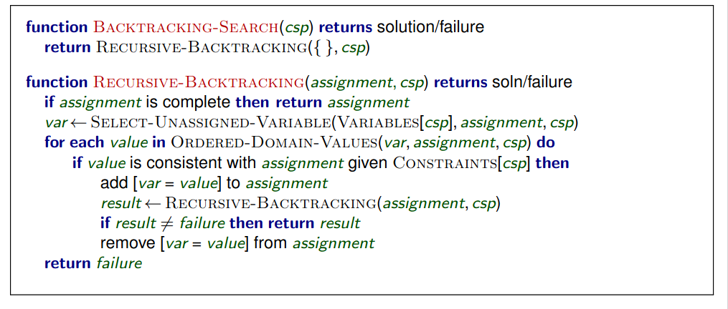
Back tracking search

Slide 15

Back tracking search example

Slide 16
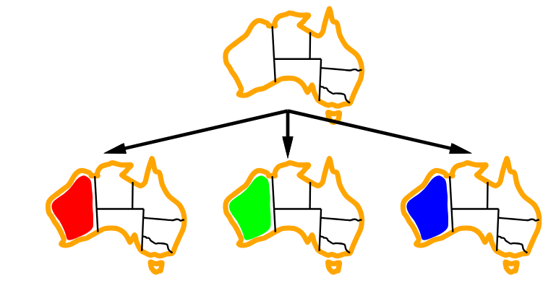
Back tracking search example

Slide 17
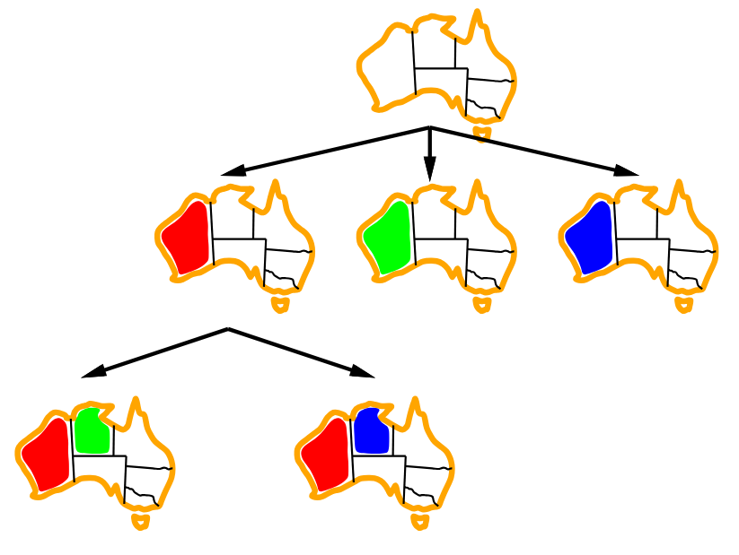
Back tracking search example

Slide 18
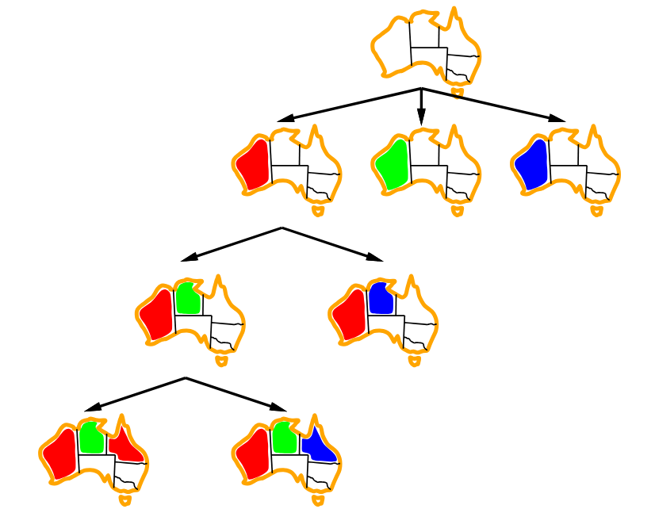
Back tracking search example

Slide 19
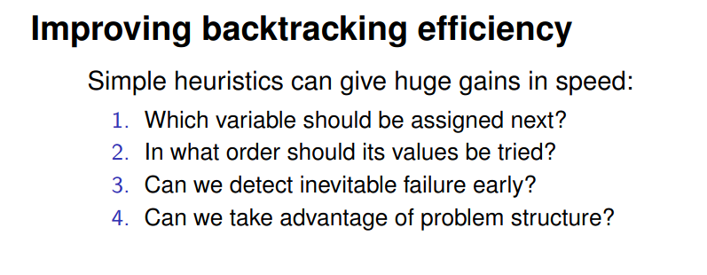
Back tracking search example

Slide 20
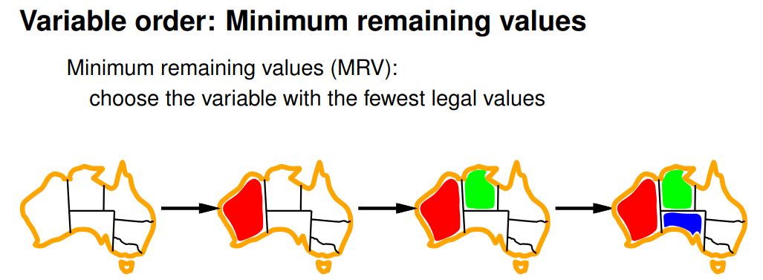
Back tracking search example

Slide 21
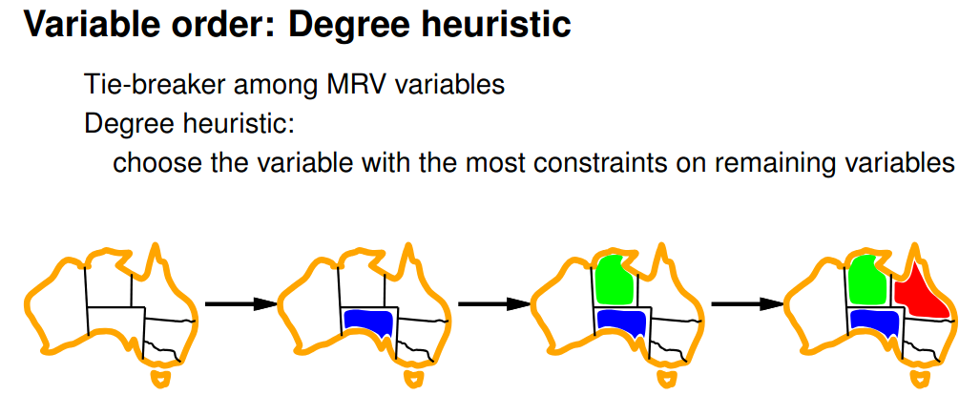
Back tracking search example

Slide 22
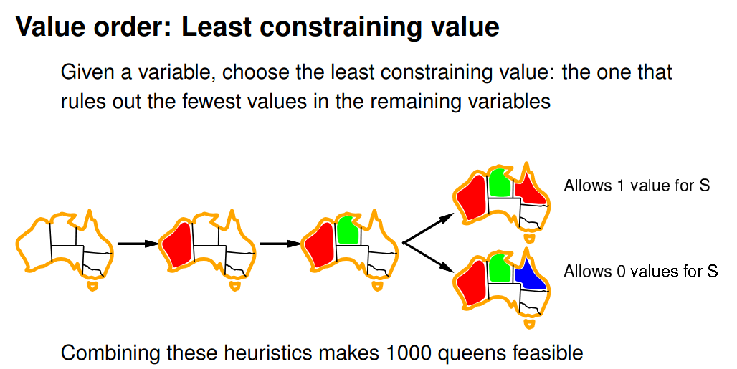
Back tracking search example

